Slide 1
Hierarchical Routing

Slide 2
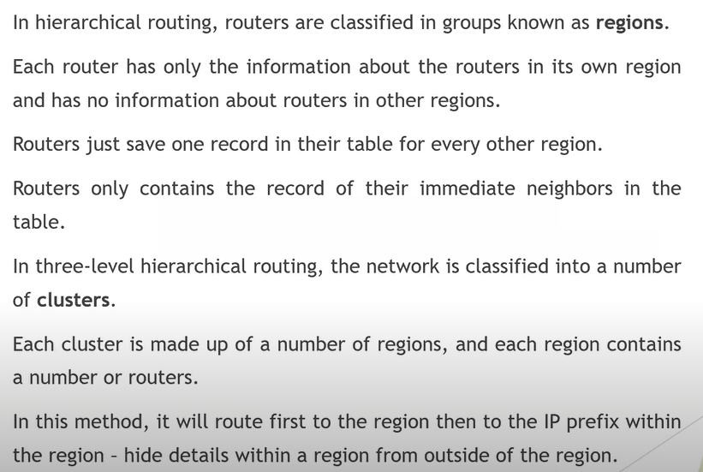

Slide 3
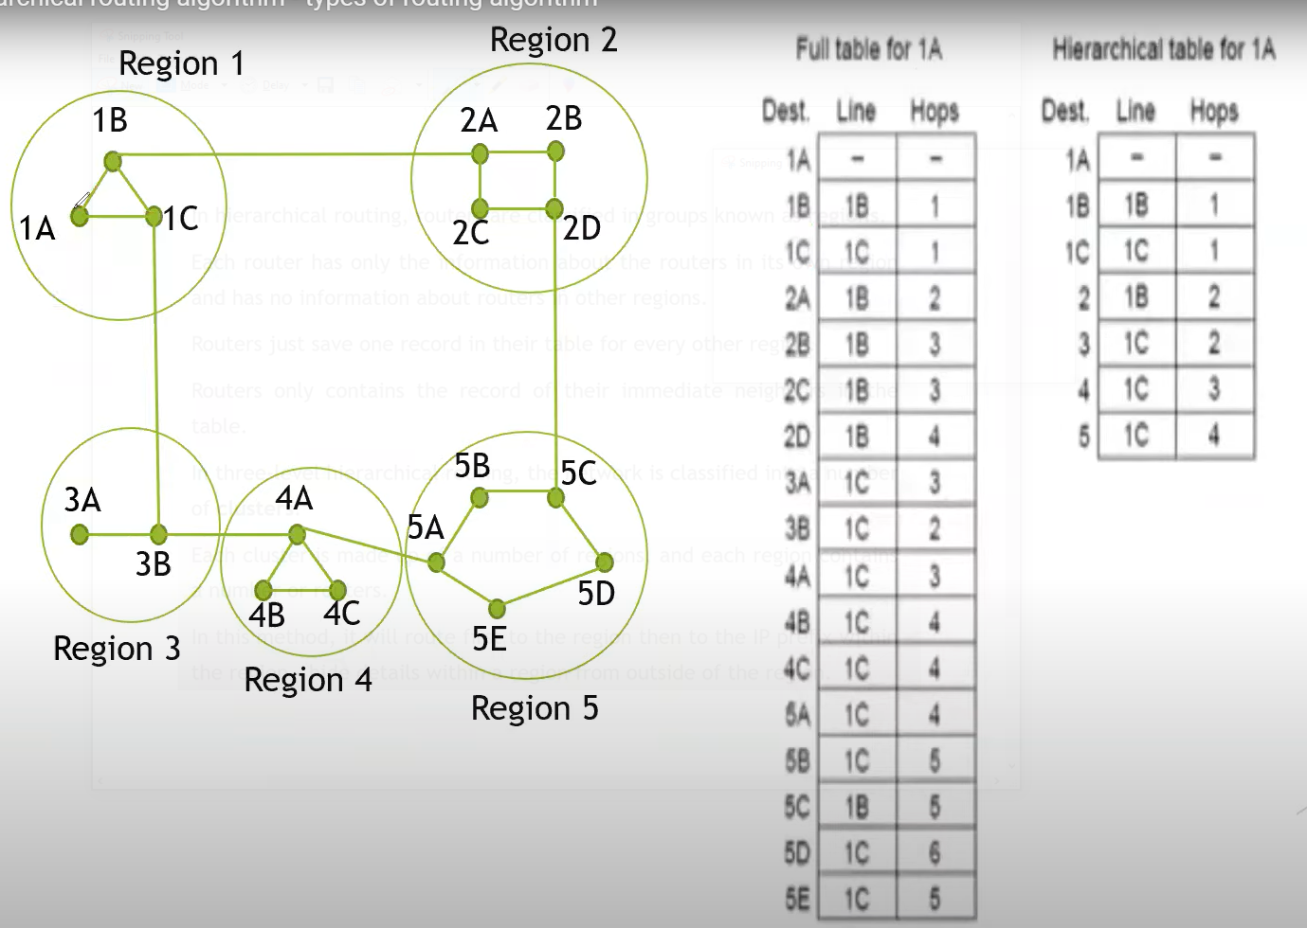

Slide 4
